Slide 1
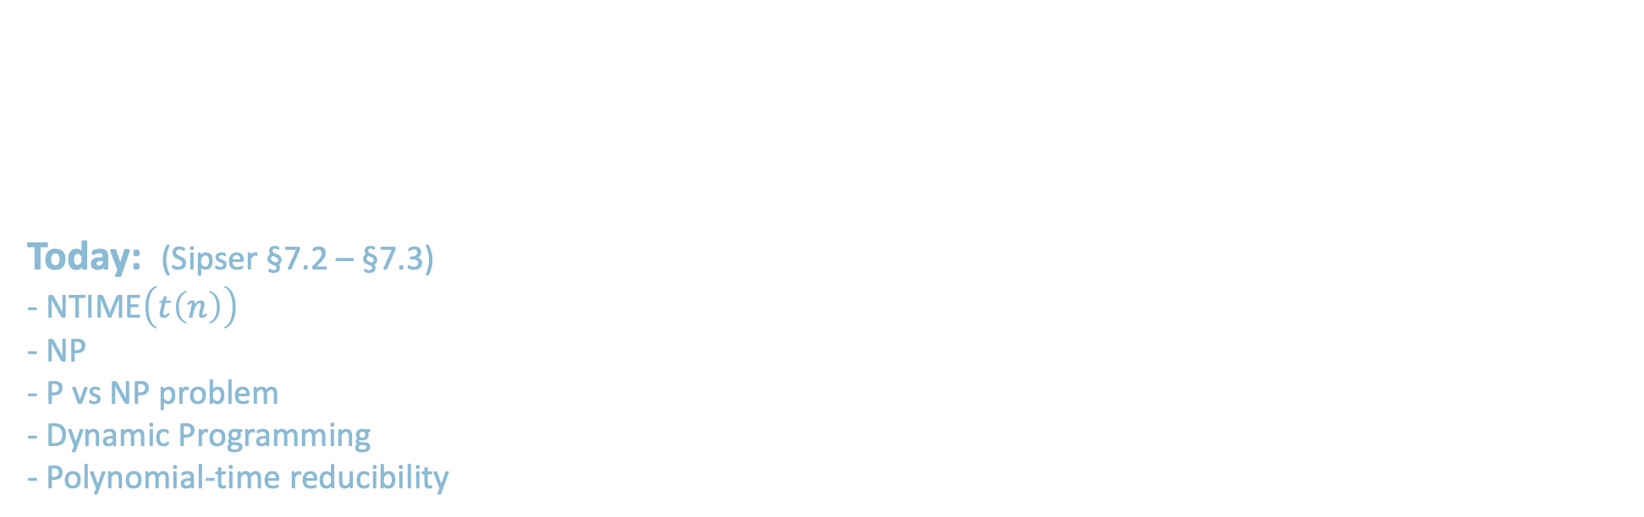
18.404/6.840 Lecture 14
(midterm replaced lecture 13)
Last time: - TIME$\left(t\left(n\right)\right)$
- P$=\bigcup_{k}{\text{TIME}(n^{k})}$
- $PATH∈\text{P}$
Today: (Sipser §7.2 – §7.3) - NTIME$\left(t\left(n\right)\right)$
- NP
- P vs NP problem
- Dynamic Programming
- Polynomial-time reducibility
1

Slide 2




Quick Review
Defn: TIME$\left(t\left(n\right)\right)=\{B|$some deterministic 1-tape TM $M$ decides $B$ and $M$ runs in time $O\left(t\left(n\right)\right)\}$
Defn: P$=\bigcup_{k}{\text{TIME}(n^{k})}$
$=$ polynomial time decidable languages
$PATH=\left\{〈G,s,t〉\right| G$ is a directed graph with a path from $s$ to $t$ $\}$
Theorem: $PATH∈\text{P}$
$HAMPATH=\left\{〈G,s,t〉\right| G$ is a directed graph with a path from $s$ to $t$ that goes through every node of $G \}$
$HAMPATH∈\text{P}$ ? Unsolved Problem
[connection to factoring]
$$G$$
$$s$$
$$t$$
2

Slide 3

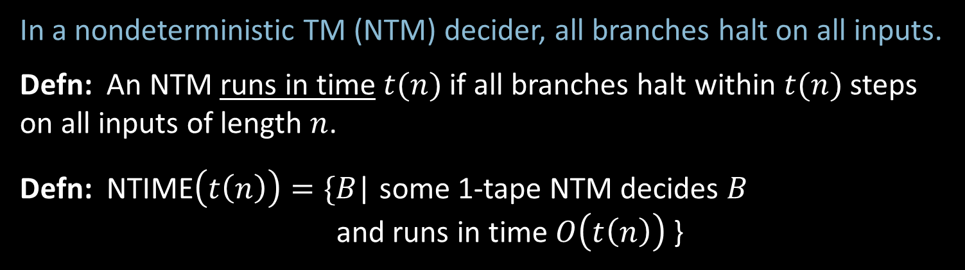



Nondeterministic Complexity
In a nondeterministic TM (NTM) decider, all branches halt on all inputs.
Defn: An NTM runs in time $t(n)$if all branches halt within $t(n)$ steps on all inputs of length $n$.
Defn: NTIME$\left(t\left(n\right)\right)=\{$𝐵| some 1-tape NTM decides 𝐵 and runs in time $O\left(t\left(n\right)\right)$ }
Computation tree for NTM on input $w$.
Defn: NP$=\bigcup_{k}{\text{NT}\text{IME}(n^{k})}$
$=$ nondeterministic polynomial time decidable languages
Invariant for all reasonable nondeterministic models
Corresponds roughly to easily verifiable problems
$$t\left(n\right)$$
. . .
all branches halt within $t(n)$ steps
3

Slide 4












$HAMPATH∈$ NP
Computation of M on $〈G,s,t〉$
Theorem: $HAMPATH∈$ NP
Proof:
“On input $〈G,s,t〉$ (Say $G$ has $m$ nodes.)
1. Nondeterministically write a sequence
$v_{1},v_{2},…, v_{m}$ of $m$ nodes.
2. Accept if $v_{1}=s$
$v_{m}=t$
each $(v_{i},v_{i+1})$ is an edge
and no $v_{i}$ repeats.
3. Reject if any condition fails.”
Guess bits of $v_{1}$
$$⋮$$
Guess bits of $v_{2}$
$$⋮$$
$$⋮$$
Guess bits of $v_{m}$
$$⋮$$
$$⋯$$
Check $v_{1},v_{2},…, v_{m}$ works
acc/rej
acc/rej
4

Slide 5



$COMPOSITES∈$ NP
Defn: $COMPOSITES=\left\{x\right| x$is not prime and $x$ is written in binary}
$=\left\{x\right| x=yz$ for integers $y,z>1$, $x$ in binary}
Theorem: $COMPOSITES∈$ NP
Proof: “On input $x$
1. Nondeterministically write $y$ where $1<y<x$.
2. Accept if $y$ divides $x$ with remainder $0$. Reject if not.”
Note: Using base 10 instead of base 2 wouldn’t matter because can convert in polynomial time.
Bad encoding: write number $k$ in unary: $1^{k}=\overset{k}{\overbrace{111⋯1}}$ , exponentially longer.
Theorem (2002): $COMPOSITES∈$ P We won’t cover this proof.
5
Notes:
Agrawal–Kayal–Saxena

Slide 6
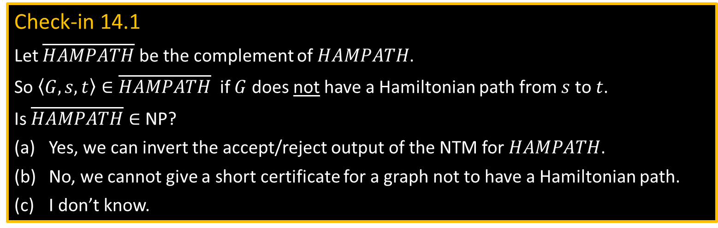

Intuition for P and NP
NP = All languages where can verify membership quickly
P = All languages where can test membership quickly
Examples of quickly verifying membership:
- $HAMPATH$: Give the Hamiltonian path.
- $COMPOSITES$: Give the factor.
The Hamiltonian path and the factor are called short certificates of membership.
P $⊆$NP
Question: P = NP? Famous unsolved problem (Cook 1971).
Conjecture: P ≠ NP. Some problems are NP and not in P.
Hard to prove the conjecture because polynomial-time algorithms are powerful.
Example: Show $A\text{CF}\text{G}∈$ P.
Check-in 14.1
Let $\overline{HAMPATH}$ be the complement of $HAMPATH$.
So $〈G,s,t〉∈\overline{HAMPATH}$ if $G$ does not have a Hamiltonian path from $s$ to $t$.
Is $\overline{HAMPATH}∈$ NP?
Yes, we can invert the accept/reject output of the NTM for $HAMPATH$.
No, we cannot give a short certificate for a graph not to have a Hamiltonian path.
I don’t know.
P
NP
6
Check-in 14.1

Slide 7



Recall $A\text{CFG}$
Recall: $A\text{CFG}$ $=\{〈G,w〉| G \text{is} \text{a} \text{CFG} \text{and} w∈L\left(G\right)\}$
Theorem: $A\text{CFG}$ is decidable
Proof: $D\text{A}\text{−}\text{CFG}=$ “On input $〈G,w〉$
Convert $G$ into Chomsky Normal Form.
Try all derivations of length $2|w|−1$.
Accept if any generate $w$. Reject if not.
Theorem: $A\text{CFG}$ $∈$NP
Proof: “On input $〈G,w〉$
Nondeterministically pick some derivation of length $2|w|−1$.
Accept if it generates $w$. Reject if not.
Chomsky Normal Form (CNF): A $→$ BC
B $→$ b
Let’s always assume $G$ is in CNF.
7

Slide 8





Attempt to show $A\text{CFG}∈$ P
Theorem: $A\text{CFG}∈$ P
Proof attempt:
Recursive algorithm $C$ tests if $G$ generates $w$, starting at any specified variable R.
$C=$“On input $〈G,w,\text{R}〉$
1. For each way to divide $w=xy$ and for each rule R $→$ST
2. Use $C$ to test $〈G,x,\text{S}〉$ and $〈G,y,\text{T}〉$
3. Accept if both accept
4. Reject if none of the above accepted.”
Then decide $A\text{CFG}$ by starting from $G$’s start variable.
$C$ is a correct algorithm, but it takes non-polynomial time.
(Each recursion makes $O(n)$ calls and depth is roughly $log⁡n$.)
Fix: Use recursion + memory called Dynamic Programming (DP)
Observation: String $w$of length $n$ has $O(n^{2})$ substrings $w_{i}⋯w_{j}$
therefore there are only $O(n^{2})$ possible sub-problems $〈G,x,\text{S}〉$ to solve.
R
S
T
$$x$$
$$y$$
$$w$$
8

Slide 9




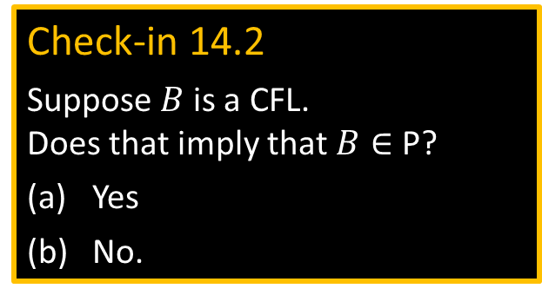

DP shows $A\text{CFG}∈$ P
Theorem: $A\text{CFG}∈$ P
Proof : Use DP (Dynamic Programming) = recursion + memory.
$D=$“On input $〈G,w,\text{R}〉$
“memoization”
0. If previously solved $〈G,w,\text{R}〉$ then answer same, else continue.
1. For each way to divide $w=xy$ and for each rule R $→$ST
2. Use $D$ to test $〈G,x,\text{S}〉$ and $〈G,y,\text{T}〉$
3. Accept if both accept
4. Reject if none of the above accepted.”
Then decide $A\text{CFG}$ by starting from G’s start variable.
same as before
R
S
T
Check-in 14.2
Suppose $B$ is a CFL. Does that imply that $B∈$ P?
Yes
No.
Total number of calls is $O(n^{2})$ so time used is polynomial.
Alternately, solve all smaller sub-problems first: “bottom up”
$$x$$
$$y$$
$$w$$
9
Check-in 14.2

Slide 10



$A\text{CFG}∈$ P & Bottom-up DP
Theorem: $A\text{CFG}∈$ P
Proof : Use bottom-up DP.
$D=$“On input $〈G,w〉$
1. For each $w_{i}$and variable R Solve $〈G,w_{i},\text{R}〉$ by checking if R $→w_{i}$ is a rule.
2. For $k=2,…, n$ and each substring $u$ of $w$ where $\left|u\right|=k$ and variable R
Solve $〈G,u,\text{R}〉$ by checking for each R $→$ST and each division $u=xy$
if both $〈G,x,\text{S}〉$ and $〈G,y,\text{T}〉$ were positive.
3. Accept if $〈G,w,\text{S}〉$ is positive where S is the original start variable.
4. Reject if not.”
Total number of calls is $O(n^{2})$ so time used is polynomial.
Often, bottom-up DP is shown as filling out a table.
Solve for substrings of length 1
Solve for substrings of length $k$ by using previous answers for substrings of length $<k$.
10

Slide 11
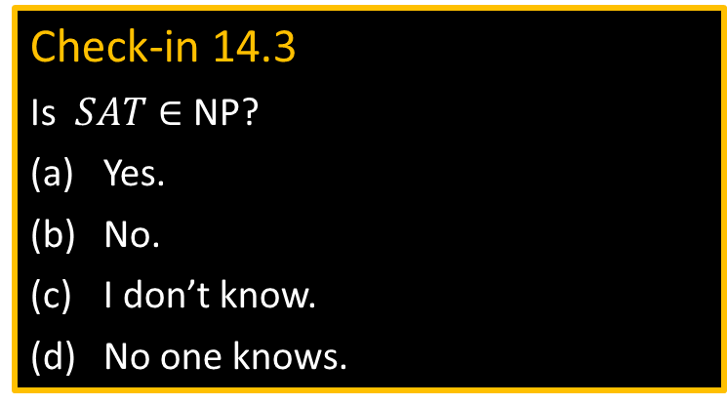

Satisfiability Problem
Defn: A Boolean formula $φ$ has Boolean variables (True/False values) and Boolean operations And ($∧$), Or ($∨$), and Not ($¬$).
Defn: $φ$ is satisfiable if $φ$evaluates to True for some assignment to its variables.
Sometimes we use 1 for True and 0 for False.
Example: Let $φ= \left(x∨y\right)∧(\overline{x}∨\overline{y})$ (Notation: $\overline{x}$ means $¬x$)
Then $φ$ is satisfiable (x=1, y=0)
Defn: $SAT=\left\{〈φ〉\right| φ$ is a satisfiable Boolean formula}
Theorem (Cook, Levin 1971): $SAT∈$ P $→$ P = NP
Proof method: polynomial time (mapping) reducibility
Check-in 14.3
Is $SAT∈$ NP?
Yes.
No.
I don’t know.
No one knows.
11
Check-in 14.3

Slide 12











Polynomial Time Reducibility
Defn: $A$ is polynomial time reducible to $B$ ($A≤_{P}B$) if $A≤_{m}B$ by a reduction function that is computable in polynomial time.
Theorem: If $A≤_{P}B$ and $B∈$P then $A∈$ P.
$$A$$
$$f$$
$$B$$
NP
$f$ is computable in polynomial time
$$SAT$$
T-recognizable
P
$$≤_{P}$$
$$A\text{TM}$$
decidable
$$≤_{m}$$
Idea to show $SAT∈$ P $→$ P = NP
Analogy with $A\text{TM}$
12

Slide 13

Quick review of today
NTIME$\left(t\left(n\right)\right)$ and NP
$HAMPATH$ and $COMPOSITES∈$ NP
P versus NP question
$A\text{CFG}∈$ P via Dynamic Programming
The Satisfiability Problem $SAT$
Polynomial time reducibility
13

Slide 14
MIT OpenCourseWare
https://ocw.mit.edu
18.404J Theory of Computation
Fall 2020
For information about citing these materials or our Terms of Use, visit: https://ocw.mit.edu/terms.

